Slide 1
Harsh curve errors
Ryan Yi

Slide 2


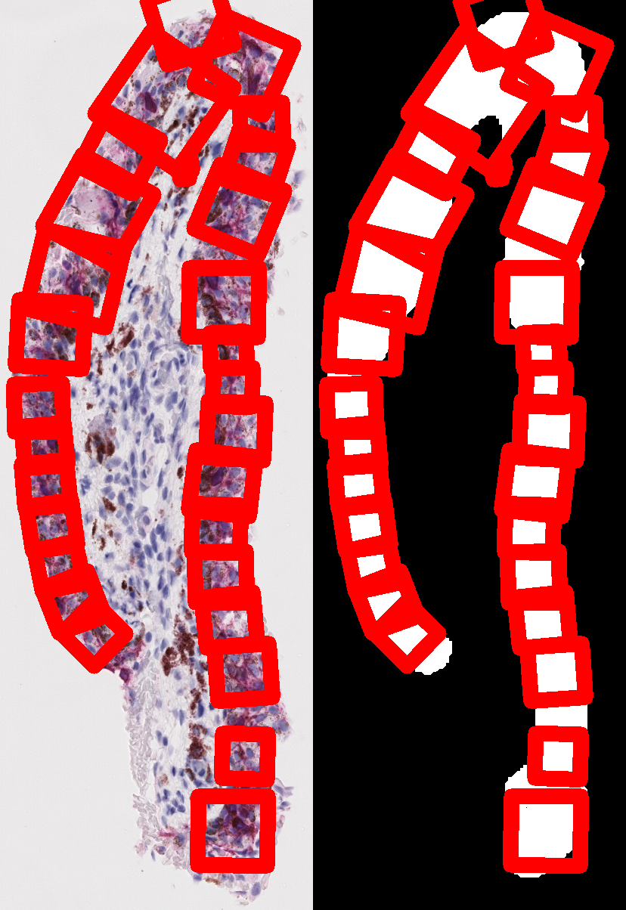
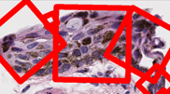
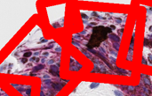

Problem pictures
All exist right before a harsh curve.
Ex. if we were to imagine it like a curve with a local maxima/minima, it usually is a couple of pixels to the left or right of it
Not really a small patch issue, it just happens to be a small patch but large patches with same characteristics exist. Indicating that its a tangent/normal issue

Slide 3


Looking into a specific case_12_match_1_sox10
Look carefully at the slopes of the micro imperfections
My hypothesis is that these small imperfections give the algorithm a chance to create a point on the imperfection, resulting in a normal going in a way it probably shouldn’t go.
Most of the time, it's a super small patch because it touches the non epithelium pretty early, but sometimes it can go on for a long time creating a large “small patch”

Slide 4
conclusions
If you look closely there are slight imperfections due to the pixel scaling. As a result there are slight ridges that cause the normal to look something like in the image on the right. There needs to be a way to filter out.
Many ways to do this, most obvious being to change the smoothing parameters.
Not unique to just small patches. Can exist for large patches

